Slide 1
Click Title
Sustainability
Notes:
This workshop was designed as part of the STE(A)M in Junior Cycle initiative, during the 2019/2020 academic year

Slide 2
Who are we?
Elspeth Sinclair
Fergus McAuliffe
Siobhán Power
Amrine Dubois Gafar
This workshop was jointly developed by Geological Survey Ireland and iCRAG for the 2019/2020 STE(A)M in Junior Cycle initiative

Slide 3
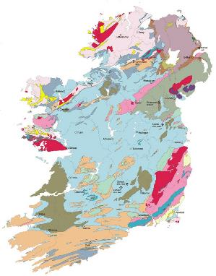
Who are we?
Geological Mapping
Marine and Coastal Unit
Groundwater and Geothermal Unit
Tellus
Minerals
Geoheritage
Communications and Education
Research
www.gsi.ie

Slide 4
Our research:
Solutions for a sustainable society
Earth resources
Earth system change

Slide 5
The 100,000 People Challenge

Slide 6
Learning intentions
Explore the factors that influence where cities can be built.
Evaluate information and formulate an effective method of powering a new city.
Review the decisions made during this exercise and discuss the outcome of your new city.
Notes:
We will interrogate these learning intentions and will return to them at the end of the session.

Slide 7
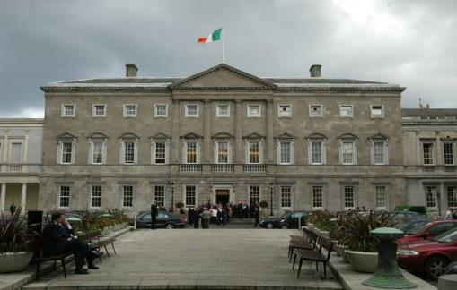
Your task today is to relocate the administrative centre of Ireland.

Slide 8
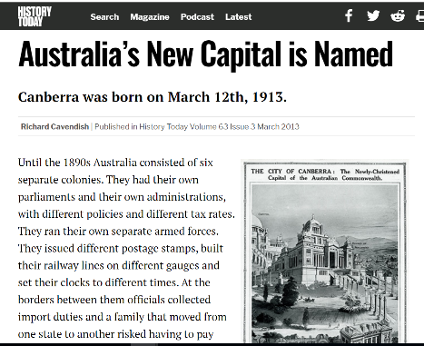
It’s been done before...

Slide 9
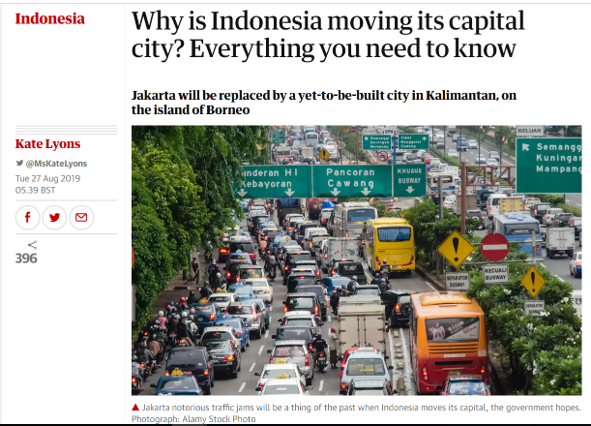
And it might be done again!

Slide 10
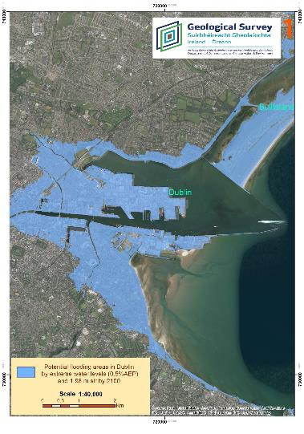
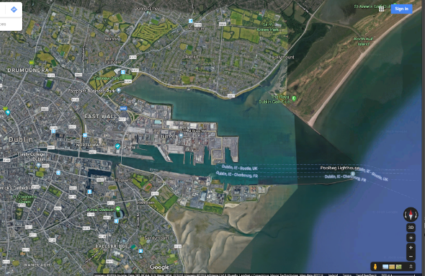
The changing climate will effect Ireland.
Modelled flooding for 2100.
Dublin as we know it in 2019.
Dublin 2100?
Notes:
Coastal Vulnerability Index - 'Potential flooding areas in Dublin from a 0.5 Annual exceedance probability (AEP) event and 1.98m sea-level rise, worst case scenario, projected by 2100’. This potential flooding projection 2100 is part of Silvia Caloca's thesis published in 2018 using available data at the time. It is not intended to be used for planning or uses other than support the study of the coastal vulnerability mapping project.
More information: https://www.gsi.ie/en-ie/programmes-and-projects/marine-and-coastal-unit/projects/Pages/Coastal-Vulnerability-Index.aspx

Slide 11
Imagine - you want to start a colony on Mars. What do you need to survive? What are the challenges you would face?
Go to www.menti.com and use the code
Notes:
Suggestion: use Mentimeter for this word cloud exercise. As the teacher you make an account and post the questions on Mentimeter. The students go to www.menti.com and input the code generated from your exercise.
We combined the two questions when using Mentimeter. Students should come up with things such as water, food, shelter etc.

Slide 12
Work for today.
You will be given 4 locations.
Information will be provided in rounds.
With each new round of information, you will eliminate a location.
For the final round, you will calculate a carbon score.
Finally, you will present the rationale for your decisions.

Slide 13
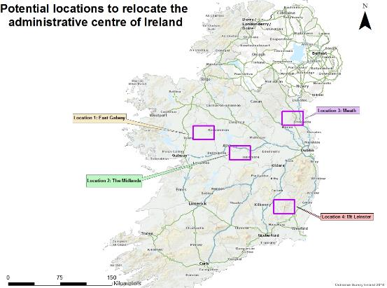
Here are your locations
Notes:
Handout needs to be given out. Handouts and explainers found in ‘Handouts_100,000PeopleChallenge’ document

Slide 14
Round 1: Water
Your first thing to consider is water.
Which location will you eliminate? Why?
Notes:
Consider both positive and negative aspects of water.
Handout needs to be given out. Handouts and explainers found in ‘Handouts_100,000PeopleChallenge’ document

Slide 15
DECISION TIME
Notes:
Eliminate one area based on flooding maps. There are now 3 areas to consider.

Slide 16
Round 2: Raw materials
Look at the bedrock and Quaternary maps.
You now need to consider raw materials:
Rock type – limestone and granite – for building and water
Aggregates – Quaternary deposits of eskers and drumlins – for construction
Metals and mineral deposits – requirements for renewable energy
Notes:
(Just Transition, carbon footprint reduced, supporting local economy)
Handout needs to be given out. Handouts and explainers found in ‘Handouts_100,000PeopleChallenge’ document

Slide 17
DECISION TIME
Notes:
Eliminate another area based on bedrock geology and Quaternary sediments maps. There are now 2 areas to consider.

Slide 18
Round 3: Renewable energy
Step 1 – consider three renewable energy sources:
Wind
Solar
Geothermal
For energy security, two sources of energy are needed to power the new city.
Some energy sources are better suited to some areas than others depending on location.
Notes:
Handout needs to be given out. Handouts and explainers found in ‘Handouts_100,000PeopleChallenge’ document

Slide 19
Round 3: Renewable energy
Step 2
You will calculate a carbon score based on:
A: Energy potential
B: Proximity to resource
The final score is a combination of both.
The lower the score the more sustainable for that location.
Notes:
Handout needs to be given out. Handouts and explainers found in ‘Handouts_100,000PeopleChallenge’ document

Slide 20
DECISION TIME
Notes:
Eliminate one more area based on calculations in Round 3. You are now left with the final location.

Slide 21
Discussion and Presentation.
Considering all the information, including the maps of
Special Areas of Conservation (SACs), discuss the rationale for your final location in terms of:
Sustainability
Natural resources: water, raw materials and energy
Carbon score
Quality of life
And any other factors listed on the Menti exercise.
Each team will give a synopsis on how you reached your final choice.
Notes:
There is no right or wrong answer for this workshop. The key thing is to discuss the process and findings

Slide 22
Resources used in today’s activity
This presentation
Ordnance Survey maps www.osi.ie
Geological, Quaternary, and flooding maps from Geological Survey Ireland www.gsi.ie
Special Areas of Conservation maps from National Parks and Wildlife Service www.npws.ie
Most of these maps are open source
Thank you for your attention!

Slide 23
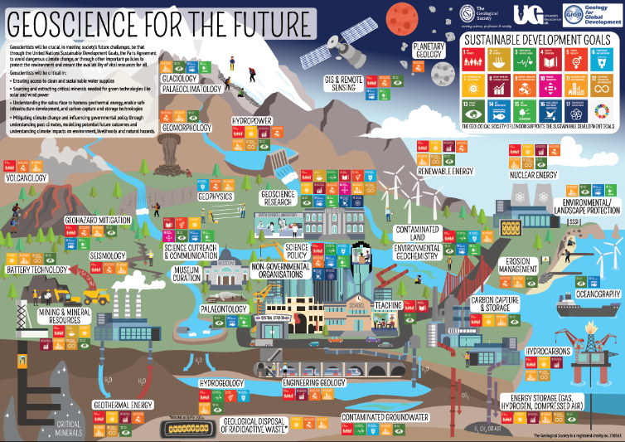
Notes:
Examples of how geosciences contribute to society.

